Slide 1
Programmable Logic Devices

Slide 2
Definitions
Programmable Logic Device (PLD):
Also known as “Field Programmable Logic Device (FPLD)”
An integrated circuit chip that can be configured by the user to implement different digital hardware.

Slide 3
Programmable Logic Devices
PLD (generic)
An IC where the logic function can be programmed into it after manufacture
In some cases, it can be reprogrammed if a bug in the design is discovered
PLA (programmable logic array)
The first PLD on the market
Two level AND/OR array structure with user programmable connections
PAL (programmable array logic)
Appeared on the scene after PLA’s
Lower cost
The MSI of the programmable industry; sometimes simply called PLD
ROM (read-only memory)
Originally not thought of as a programmable device at all – simply a memory for holding machine specific information, such as the control store operation
CPLD (complex programmable logic device)
A collection of PLD’s on a chip with programmable on-chip interconnections
FPGA (field programmable gate array)
Another scheme developed same time as CPLD
Large number of basic logic blocks (simple gates) with prog X/Y interconnection

Slide 4
The first three varieties(ROM, PLA, PAL) are quite
similar to each other:
- They all have an input connection matrix, which connects the inputs of the device to an array of AND-gates.
- They all have an output connection matrix, which connect the outputs of the AND-gates to the inputs of OR-gates which drive the outputs of the device.

Slide 5
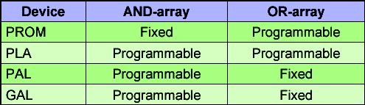
PLD
The differences between the first three categories are these:
1. In a ROM, the input connection matrix is hardwired. The user can modify the output connection matrix.
In a PAL/GAL the output connection matrix is hardwired. The user can modify the input connection matrix.
In a PLA the user can modify both the input connection matrix and the output connection matrix.

Slide 6
Purpose of PLDs
Permits elaborate digital logic designs to be implemented by the user on a single device.
Is capable of being erased and reprogrammed with a new design.

Slide 7
Advantages of PLDs
Programmability
Re-programmability
PLDs can be reprogrammed without being removed from the circuit board.
Low cost of design
Immediate hardware implementation

Slide 8
Types of PLDs
PLD
SPLD
PAL
GAL
HCPLD
CPLD
ROM
PLA
FPGA

Slide 9
Types of PLDs
SPLDs (Simple Programmable Logic Devices)
ROM (Read-Only Memory)
PLA (Programmable Logic Array)
PAL (Programmable Array Logic)
GAL (Generic Array Logic)
HCPLD (High Capacity Programmable Logic Device)
CPLD (Complex Programmable Logic Device)
FPGA (Field-Programmable Gate Array)

Slide 10
SPLDs
In ROM, the input connection matrix is hardwired and the user can only modify the output connection matrix.
In PAL and GAL the output connection matrix is also hardwired and the user can modify the input connection matrix.
In PLA the user can modify both the input connection matrix and the output connection matrix.

Slide 11
HCPLDs
CPLD (Complex Programmable Logic Device)
Lies between PALs and FPGAs in degree of complexity.
Inexpensive
FPGA (Field-Programmable Gate Array)
Truly parallel design and operation
Fast turnaround design
Array of logic cells surrounded by programmable I/O blocks

Slide 12
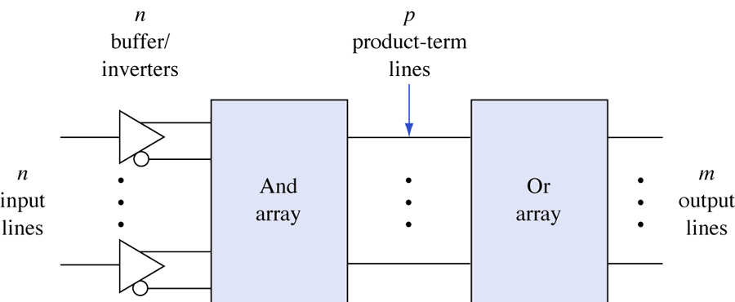
General structure of PLDs.

Slide 13
Programmable Logic Organization
Pre-fabricated building block of many AND/OR gates (or NOR, NAND)
"Personalized" by making or breaking connections among the gates
Inputs
Dense array of
Dense array of
AND gates
Product
OR gates
terms
Outputs
Programmable Array Block Diagram for Sum of Products Form

Slide 14
PLD as a Black Box
Logic gates
Inputs
and
Outputs
(logic variables)
programmable
(logic functions)
switches

Slide 15
Basic Programmable Logic Organizations
Depending on which of the AND/OR logic arrays is programmable, we have three basic organizations
ORGANIZATION
PAL
PROM
PLA
AND ARRAY
PROG.
FIXED
PROG.
OR ARRAY
FIXED
PROG.
PROG.

Slide 16
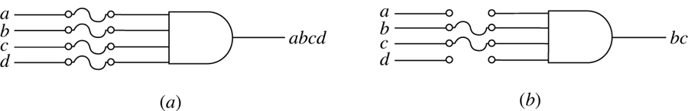
Programming by blowing fuses.
(a) Before programming. (b) After programming.

Slide 17
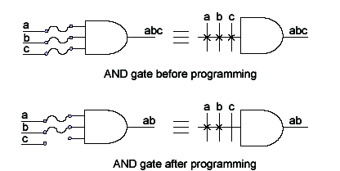
AND - PLD Notation

Slide 18
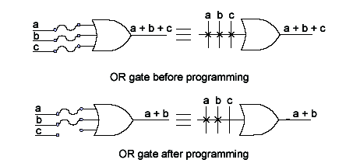
OR - PLD Notation

Slide 19
Memory and Programmable Logic

Slide 20
Memory
Random Access Memory (RAM)
Contrary to Serial Access Memory (e.g. Tape)
Static Random Access Memory (SRAM)
Data stored so long as Vdd is applied
6-transistors per cell
Faster
Differential
Dynamic Random Access Memory (DRAM)
Require periodic refresh
Smaller (can be implemented with 1 or 3 transistor)
Slower
Single-Ended
Can be read and written
Typically, addressable at byte granularity
Read-Only Memory (ROM)

Slide 21
ROM Types
Mask programmable ROM
fuses programmed during manufacture
Programmable ROM (PROM)
0’s programmed by blowing fuses or “burning”
Erasable PROM (EPROM)
programming erased by UV light
Electrically erasable PROM (EEPROM)
programming erased via control signals

Slide 22
Block Diagram of Memory
N-bit Data Input
(for Write)
N
K-bit address lines
Memory Unit
K
Read/Write
2^{k} words
N-bit per word
Chip Enable
N
N-bit Data Output
(for Read)
Example: 2MB memory, byte-addressable
N = 8 (because of byte-addressability)
K = 21 (1 word = 8-bit)

Slide 23
Memory Description
Capacity of a memory is described as
# addresses x Word size
Examples:
Memory | # of addr | # of data lines | # of addr lines | # of total bytes
1M x 8 | 1,048,576 | 8 | 20 | 1 MB
2M x 4 | 2,097,152 | 4 | 21 | 1 MB
1K x 4 | 1024 | 4 | 10 | 512 B
4M x 32 | 4,194,304 | 32 | 22 | 16 MB
16K x 64 | 16,384 | 64 | 14 | 128 KB

Slide 24
How to Address Memory
4x8 Memory
2-to-4
Decoder
0
1-bit
1-bit
1-bit
1-bit
1-bit
1-bit
1-bit
1-bit
A0
1
1-bit
1-bit
1-bit
1-bit
1-bit
1-bit
1-bit
1-bit
2
A1
1-bit
1-bit
1-bit
1-bit
1-bit
1-bit
1-bit
1-bit
3
CS
1-bit
1-bit
1-bit
1-bit
1-bit
1-bit
1-bit
1-bit
Chip
Select
D7
D6
D5
D4
D3
D2
D1
D0

Slide 25
How to Address Memory
4x8 Memory
2-to-4
Decoder
0
1-bit
1-bit
1-bit
1-bit
1-bit
1-bit
1-bit
1-bit
A0=1
1
1-bit
1-bit
1-bit
1-bit
1-bit
1-bit
1-bit
1-bit
2
A1=0
1-bit
1-bit
1-bit
1-bit
1-bit
1-bit
1-bit
1-bit
3
CS
1-bit
1-bit
1-bit
1-bit
1-bit
1-bit
1-bit
1-bit
Chip
Select=1
D7
D6
D5
D4
D3
D2
D1
D0
Access address = 0x1

Slide 26
Use 2 Decoders
8x4 Memory
2-to-4
Decoder
Row
Decoder
0
1-bit
1-bit
1-bit
1-bit
1-bit
1-bit
1-bit
1-bit
A1
1
1-bit
1-bit
1-bit
1-bit
1-bit
1-bit
1-bit
1-bit
2
A2
1-bit
1-bit
1-bit
1-bit
1-bit
1-bit
1-bit
1-bit
3
CS
1-bit
1-bit
1-bit
1-bit
1-bit
1-bit
1-bit
1-bit
Tristate
Buffer
(read)
D0
D1
D2
D3
Chip
Select
0
1
CS
1-to-2 Decoder Column Decoder
A0

Slide 27
Tristate Buffer
En
Input
Output
Input
Output
En
Similar to Transmission Gate
Could amplify signal (in contrast to a TG)
Typically used for signal traveling, e.g. bus

Slide 28
Bi-directional Bus using Tri-state Buffer
Direction
(control data flow for read/write)
A
Input/Output
B

Slide 29
Read/Write Memory
8x4 Memory
0
1-bit
1-bit
1-bit
1-bit
1-bit
1-bit
1-bit
1-bit
A1
2-to-4
Row
Decoder
1
1-bit
1-bit
1-bit
1-bit
1-bit
1-bit
1-bit
1-bit
2
A2
1-bit
1-bit
1-bit
1-bit
1-bit
1-bit
1-bit
1-bit
3
CS
1-bit
1-bit
1-bit
1-bit
1-bit
1-bit
1-bit
1-bit
Rd/Wr = 0
D0
D1
D2
D3
0
1
Chip
Select = 0
CS
1-to-2 Column Decoder
A0

Slide 30
Read/Write Memory
8x4 Memory
0
1-bit
1-bit
1-bit
1-bit
1-bit
1-bit
1-bit
1-bit
A1
2-to-4
Row
Decoder
1
1-bit
1-bit
1-bit
1-bit
1-bit
1-bit
1-bit
1-bit
2
A2
1-bit
1-bit
1-bit
1-bit
1-bit
1-bit
1-bit
1-bit
3
CS
1-bit
1-bit
1-bit
1-bit
1-bit
1-bit
1-bit
1-bit
Rd/Wr = 1
D0
D1
D2
D3
0
1
Chip
Select = 1
CS
1-to-2 Column Decoder
A0

Slide 31
Building Memory in Hierarchy
Design a 1Mx8 using 1Mx4 memory chips
1Mx4
D7
D6
D5
D4
CS
R/W
A19
A19
1Mx4
D3
A18
A18
A17
A17
D2
D1
A0
A0
D0
CS
CS
R/W

Slide 32
Building Memory in Hierarchy
Design a 2Mx4 using 1Mx4 memory chips
A19
1Mx4
D3
Note that 1-to-2
decoder is the wire
itself (or use
an inverter)
A18
A17
D2
D1
D0
A0
CS
R/W
1-to-2
Decoder
A20
1
0
A19
1Mx4
A18
CS
A17
A0
CS
R/W

Slide 33
Building Memory in Hierarchy
Design a 2Mx8 using 1Mx4 memory chips
A19
A19
D7
A18
A18
1Mx4
A17
A17
D6
D5
A0
A0
CS
R/W
D4
1-to-2
Decoder
A19
1Mx4
D3
A20
1
A18
D2
A17
0
D1
A0
CS
R/W
D0
CS
A19
1Mx4
A18
A17
A0
CS
R/W
A19
1Mx4
A18
A17
A0
CS
R/W

Slide 34
Read Only Memory (ROM)
“Permanent” binary information is stored
Non-volatile memory
Power off does not erase information stored
ROM
K-bit address lines
N-bit Data Output
2^{k} words
N-bit per word
K
N

Slide 35
Programming the 32x8 ROM
A4 | A3 | A2 | A1 | A0 | D7 | D6 | D5 | D4 | D3 | D2 | D1 | D0
0 | 0 | 0 | 0 | 0 | 1 | 1 | 0 | 0 | 0 | 1 | 0 | 1
0 | 0 | 0 | 0 | 1 | 1 | 0 | 0 | 0 | 1 | 0 | 1 | 1
0 | 0 | 0 | 1 | 0 | 1 | 0 | 1 | 1 | 0 | 0 | 0 | 0
… | … | … | … | … | … | … | … | … | … | … | … | …
1 | 1 | 1 | 0 | 1 | 0 | 0 | 0 | 1 | 0 | 0 | 0 | 0
1 | 1 | 1 | 1 | 0 | 0 | 1 | 0 | 1 | 0 | 1 | 1 | 0
1 | 1 | 1 | 1 | 1 | 1 | 1 | 1 | 0 | 0 | 0 | 0 | 1
A4
0
1
A3
2
5-to-32
Decoder
A2
A1
A0
29
30
31
D7
D6
D5
D4
D3
D2
D1
D0

Slide 36
Example: Lookup Table
Design a square lookup table for F(X) = X² using ROM
X | F(X)=X²
0 | 0
1 | 1
2 | 4
3 | 9
4 | 16
5 | 25
6 | 36
7 | 49
X | F(X)=X²
000 | 000000
001 | 000001
010 | 000100
011 | 001001
100 | 010000
101 | 011001
110 | 100100
111 | 110001

Slide 37
Square Lookup Table using ROM
0
X | F(X)=X²
000 | 000000
001 | 000001
010 | 000100
011 | 001001
100 | 010000
101 | 011001
110 | 100100
111 | 110001
1
X2
3-to-8
Decoder
2
X1
3
4
X0
5
6
7
F5
F4
F3
F2
F1
F0

Slide 38
Square Lookup Table using ROM
0
X | F(X)=X²
000 | 000000
001 | 000001
010 | 000100
011 | 001001
100 | 010000
101 | 011001
110 | 100100
111 | 110001
1
X2
3-to-8
Decoder
2
X1
3
4
X0
5
6
7
F5
F4
F3
F2
F1
F0

Slide 39
Square Lookup Table using ROM
0
X | F(X)=X²
000 | 000000
001 | 000001
010 | 000100
011 | 001001
100 | 010000
101 | 011001
110 | 100100
111 | 110001
1
X2
3-to-8
Decoder
2
X1
3
4
X0
5
6
7
F5
F4
F3
F2
F1
F0
Not Used
= X0

Slide 40
Square Lookup Table using ROM
0
1
X | F(X)=X²
000 | 000000
001 | 000001
010 | 000100
011 | 001001
100 | 010000
101 | 011001
110 | 100100
111 | 110001
X2
3-to-8
Decoder
2
X1
3
4
X0
5
6
7
F5
F4
F3
F2
F1
F0

Slide 41
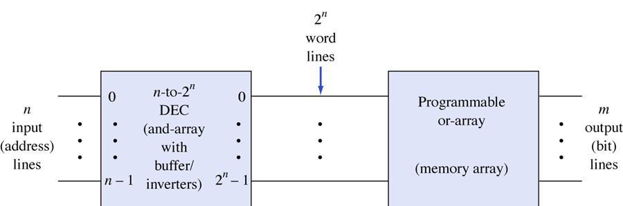
PROM Notation

Slide 42
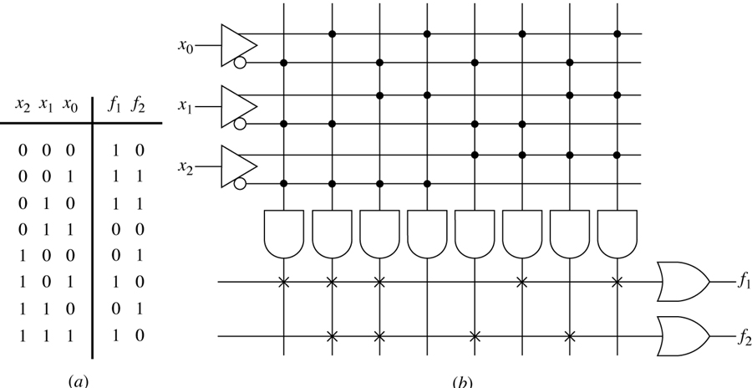
Using a PROM for logic design
(a) Truth table. (b) PROM realization.

Slide 43
Programmable Array Logic (PAL)
Also used to implement circuits in SOP form
The connections in the AND plane are programmable
The connections in the OR plane are NOT programmable
x
1
x
2
x
n
Input buffers
and
fixed connections
inverters
x
1
x
1
x
n
x
n
P
1
AND plane
OR plane
P
k
f
f
m
1

Slide 44
Example Schematic of a PAL
x
x
x
1
2
3
f₁ = x₁x₂x₃'+x₁'x₂x₃
f₂ = x₁'x₂'+x₁x₂x₃
P
1
f
1
P
2
P
3
f
2
P
4
AND plane

Slide 45
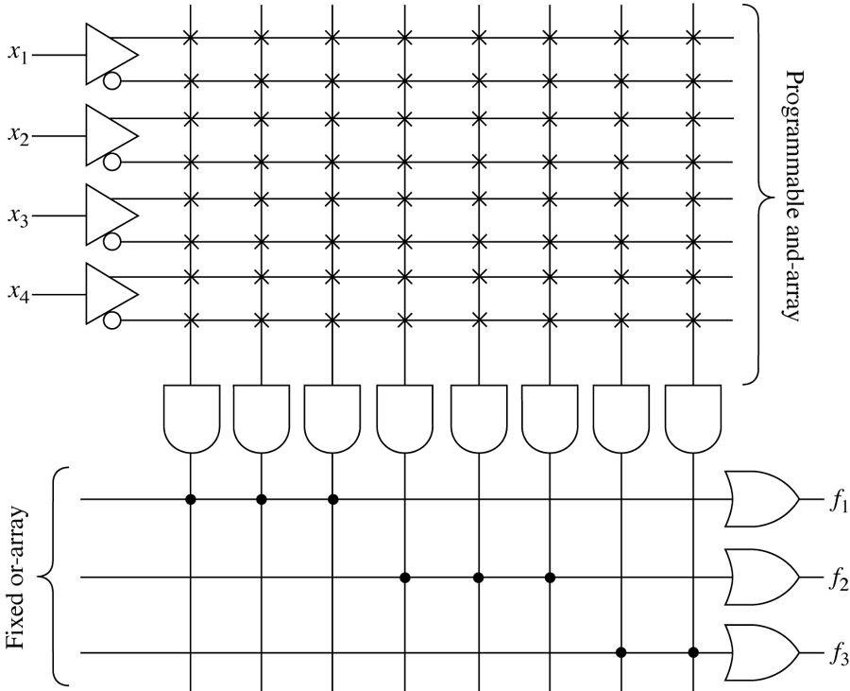
A simple four-input, three-output PAL device.

Slide 46
PAL Logic Implementation
Programmed PAL:
A B C D
A
BD
Minimized Functions:
BC
0
W = A + B D + B C
X = B C
Y = B + C
Z = A B C D + B C D + A D + B C D
BC
0
0
0
B
C
0
0
A B C D
BCD
AD
BCD
4 product terms per each OR gate
W X Y Z

Slide 47
PAL Logic Implementation
Design Example: BCD to Gray Code Converter
K-maps
Truth Table
AB
A
AB
A
A
B
C
D
W
X
Y
Z
CD
00
01
11
10
CD
00
01
11
10
0
0
0
0
0
0
0
0
00
0
0
X
1
00
0
1
X
0
0
0
0
1
0
0
0
1
0
0
1
0
0
0
1
1
01
0
1
X
1
01
0
1
X
0
0
0
1
1
0
0
1
0
D
D
0
1
0
0
0
1
1
0
11
0
1
X
X
11
0
0
X
X
0
1
0
1
1
1
1
0
C
C
0
1
1
0
1
0
1
0
10
0
1
X
X
10
0
0
X
X
0
1
1
1
1
0
1
1
1
0
0
0
1
0
0
1
B
B
1
0
0
1
1
0
0
0
K-map for
W
K-map for
1
0
1
0
X
X
X
X
X
1
0
1
1
X
X
X
X
A
A
1
1
0
0
X
X
X
X
AB
AB
1
1
0
1
X
X
X
X
CD
00
01
11
10
CD
00
01
11
10
1
1
1
0
X
X
X
X
00
0
1
X
0
00
0
0
X
1
1
1
1
1
X
X
X
X
Minimized Functions:
01
0
1
X
0
01
1
0
X
0
D
D
11
1
1
X
X
11
0
1
X
X
W = A + B D + B C
X = B C
Y = B + C
Z = A B C D + B C D + A D + B C D
C
C
10
1
1
X
X
10
1
0
X
X
B
B
K-map for
Y
K-map for
Z

Slide 48
PAL Device Design Example
A
A
B
B
C
C
D
D
IO1
IO1
IO1
Not programmed
A
IO2
B

Slide 49
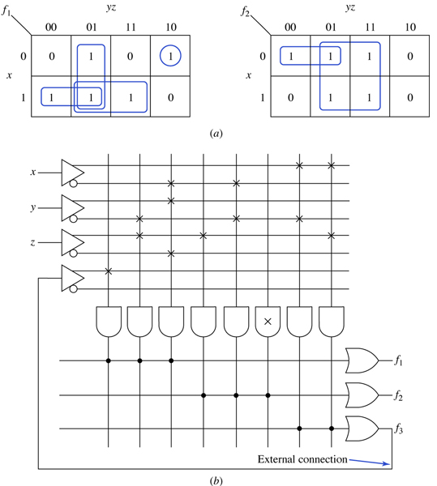
An example of using a PAL device to realize two
Boolean functions. (a) Karnaugh maps. (b) Realization.

Slide 50
PAL16V8 OLMC Configuration Modes
Simple mode (combinational output)
combinational output
combinational output with feedback
dedicated input
Complex mode
combinational output, with feedback
combinational input from another OLMC Registered mode: active (low, high): Q’ is feedback as input (no dedicated input)

Slide 51
Programmable Logic Array (PLA)
Use to implement circuits in SOP form
The connections in the AND plane are programmable
The connections in the OR plane are programmable
x
1
x
2
x
n
Input buffers
and
inverters
x
1
x
1
x
n
x
n
P
1
AND plane
OR plane
P
k
f
f
m
1

Slide 52
Customary Schematic of a PLA
x
1
x
x
2
3
f₁ = x₁x₂+x₁x₃'+x₁'x₂'x₃
OR plane
P
1
f₂ = x₁x₂+x₁'x₂'x₃+x₁x₃
P
2
P
3
P
4
x marks the connections left in place after programming
AND plane
f
f
1
2

Slide 53
Limitations of PLAs
PLAs come in various sizes
Typical size is 16 inputs, 32 product terms, 8 outputs
Each AND gate has large fan-in → this limits the number of inputs that can be provided in a PLA
16 inputs → 3¹⁶ = possible input combinations; only 32 permitted (since 32 AND gates) in a typical PLA
32 AND terms permitted → large fan-in for OR gates as well
This makes PLAs slower and slightly more expensive than some alternatives to be discussed shortly
8 outputs → could have shared minterms, but not required

Slide 54
PLA Logic Implementation
Key to Success: Shared Product Terms
Equations
F0 = A + B C
F1 = A C + A B
F2 = B C + A B
F3 = B C + A
Example:
Personality Matrix
Input Side:
Product
Inputs
Outputs
t
1 = asserted in term
0 = negated in term
- = does not participate
erm
A
B
C
F
F
F
F
0
1
2
3
A B
1
1
-
0
1
1
0
B C
-
0
1
0
0
0
1
Reuse
A C
1
-
0
0
1
0
0
of
Output Side:
t
1
0
1
0
erms
B C
-
0
0
1 = term connected to output
0 = no connection to output
A
1
-
-
1
0
0
1

Slide 55
PLA Logic Implementation
Example Continued - Unprogrammed device
A
B
C
All possible connections are available
before programming
F0
F1
F2
F3

Slide 56
PLA Logic Implementation
Example Continued -
Programmed part
A
B
C
Unwanted connections are "blown"
AB
BC
AC
BC
A
Note: some array structures
work by making connections
rather than breaking them
F0
F1
F2
F3

Slide 57
PLA Logic Implementation
Alternative representation
Unprogrammed device
Short-hand notation
so we don't have to
draw all the wires!
X at junction indicates
a connection
A B C D
AB
AB
Notation for implementing
F0 = A B + A B
F1 = C D + C D
CD
CD
Programmed device
AB+AB
CD+CD

Slide 58
PLA Logic Implementation
Design Example
A
B
C
ABC
Multiple functions of A, B, C
A
B
F1 = A B C
F2 = A + B + C
F3 = A B C
F4 = A + B + C
F5 = A ⊕ B ⊕ C
F6 = A ⊕ B ⊕ C
C
A
B
C
ABC
ABC
ABC
ABC
ABC
ABC
ABC
F1
F2
F3
F4
F5
F6

Slide 59
PLA Logic Implementation
Another Example: Magnitude Comparator
A B C D
AB
A
AB
A
ABCD
CD
00
01
11
10
CD
00
01
11
10
00
1
0
0
0
00
0
1
1
1
ABCD
01
ABCD
01
0
1
0
0
1
0
1
1
D
D
ABCD
11
0
0
1
0
11
1
1
0
1
C
C
AC
10
0
0
0
1
10
1
1
1
0
AC
B
B
BD
K-map for
EQ
K-map for
NE
BD
AB
A
AB
A
CD
00
01
11
10
CD
00
01
11
10
ABD
00
0
0
0
0
00
0
1
1
1
BCD
01
1
0
0
0
01
0
0
1
1
ABC
D
D
BCD
11
1
1
0
1
11
0
0
0
0
C
C
10
1
1
0
0
10
0
0
1
0
B
B
EQ
NE
LT
GT
K-map for
L
T
K-map for
GT

Slide 60
Programmable Logic Array (PLA)
A
Programmable
OR Plane
B
C
Programmable
AND Plane
C
C
B
B
A
A
F2

Slide 61
Example using PLA
A
B
C
AB
AC
BC
A B C
C
C
B
B
A
A
F1
F2

Slide 62
Comparing PALs and PLAs
PALs have the same limitations as PLAs (small number of allowed AND terms) plus they have a fixed OR plane → less flexibility than PLAs
PALs are simpler to manufacture, cheaper, and faster (better performance)
PALs also often have extra circuitry connected to the output of each OR gate
The OR gate plus this circuitry is called a macrocell

Slide 63
FPGA AND CPLD
FPGA - Field-Programmable Gate Array.
CPLD - Complex Programmable Logic Device
FPGA and CPLD is an advanced PLD.
Support thousands of gate where as PLD only support hundreds of gates.

Slide 64
CPLD and FPGA]
Complex Programmable Logic Device (CPLD)
Multiple PLDs (e.g. PALs, PLAs) with programmable interconnection structure
Pioneered by Altera
Field-Programmable Gate Array (FPGA)
High logic capacity with large distributed interconnection structure
Logic capacity ≈ number of 2-input NAND gates
Offers more narrow logic resources
CPLD offers logic resources with a wide number of inputs (AND planes)
Offer a higher ratio of Flip-flops to logic resources than CPLD
HCPLD (High Capacity PLD) is often used to refer to both CPLD and FPGA

Slide 65
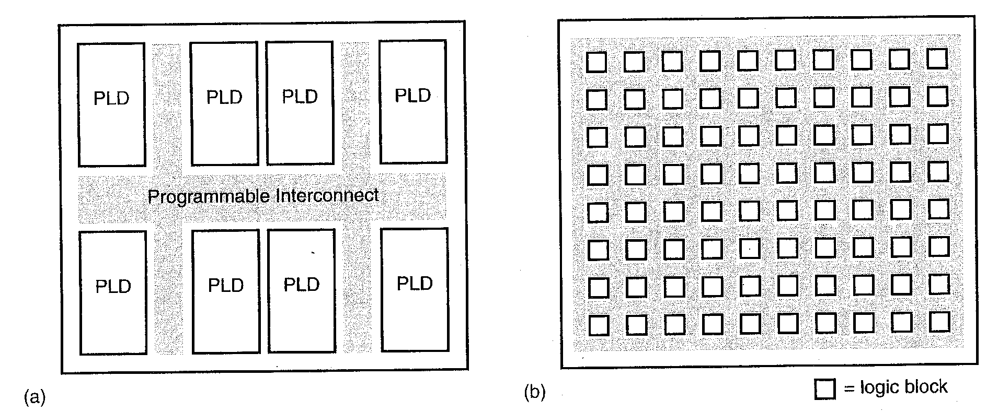
Programmable Logic Devices: CPLD vs FPGA
Complex Programmable Logic Device (CPLD): see (a) below
Most of today’s CPLD’s are simply a collection of PLD’s on a chip interconnected by programmable interconnect (wiring)
Field Programmable Gate Array (FPGA): see (b) below
FPGA’s are comprised of basic logic blocks interconnected by X and Y wiring channels

Slide 66
CPLD
Complexity of CPLD is between FPGA and PLD.
CPLD featured in common PLD:-
Non-volatile configuration memory – does not need an external configuration PROM.
Routing constraints. Not for large and deeply layered logic.
CPLD featured in common FPGA:-
Large number of gates available.
Can include complicated feedback path.
CPLD application:-
Address coding
High performance control logic
Complex finite state machines

Slide 67
Complex Programmable Logic Devices
Complex PLDs typically combine PAL combinational logic with FFs
Organized into logic blocks
Fixed OR array size
Combinational or registered output
Some pins are inputs only
Usually enough logic for simple counters, state machines, decoders, etc.

Slide 68
CPLD structure
Logic block
PLD
PLD
PLD
PLD
I/O block
PLD
PLD
PLD
PLD
Interconnects

Slide 69
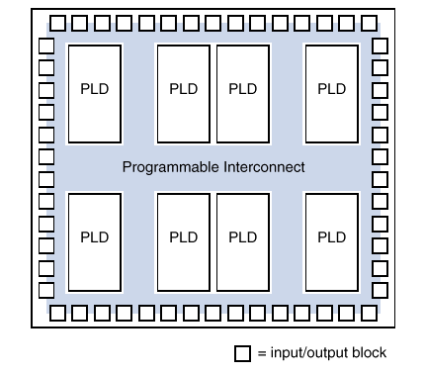
A General CPLD structure
A collection of PLDs on a single chip with
Programmble interconnects

Slide 70
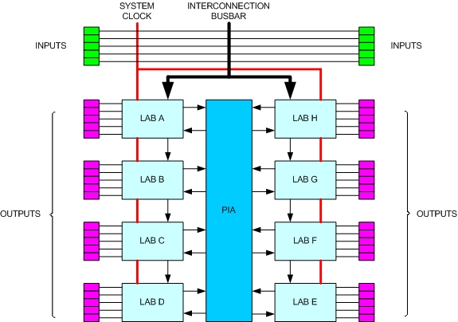
CPLD architecture
LAB – Logic Array Block / uses PALs
PIA – Programmable Interconnect Array

Slide 71
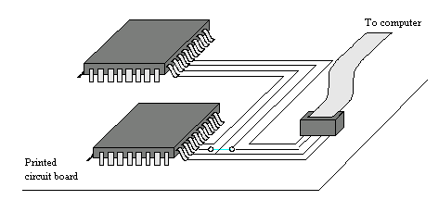
Programming a CPLD
CPLDs have many pins – large ones have > 200
Removal of CPLD from a PCB is difficult without breaking the pins
Use ISP (in system programming) to program the CPLD
JTAG (Joint Test Action Group) port used to connect the CPLD to a computer

Slide 72
Example CPLD
Use a CPLD to implement the function
f = x₁x₃x₆' + x₁x₄x₅x₆' + x₂x₃x₇ + x₂x₄x₅x₇

Slide 73
FPGA?
Before the advent of programmable logic, custom logic circuits were built at the board level using standard components, or at the gate level in expensive application-specific (custom) integrated circuits.
FPGA is an integrated circuit that contains many (64 to over 10,000) identical logic cells that can be viewed as standard components. Each logic cell can independently take on any one of a limited set of personalities.
Individual cells are interconnected by a matrix of wires and programmable switches. A user's design is implemented by specifying the simple logic function for each cell and selectively closing the switches in the interconnect matrix.
Array of logic cells and interconnect form a fabric of basic building blocks for logic circuits. Complex designs are created by combining these basic blocks to create the desired circuit

Slide 74
Field Programmable Gate Arrays (FPGAs)
FPGAs have much more logic than CPLDs
2K to >10M equivalent gates
Requires different architecture
FPGAs can be RAM-based or Flash-based
RAM FPGAs must be programmed at power-on
External memory needed for programming data
May be dynamically reconfigured
Flash FPGAs store program data in non-volatile memory
Reprogramming is more difficult
Holds configuration when power is off

Slide 75
FPGA Structure
Typical organization in 2-D array
Configurable logic blocks (CLBs) contain functional logic (could be similar to PAL22V10)
Combinational functions plus FFs
Complexity varies by device
CLB interconnect is either local or long line
CLBs have connections to local neighbors
Horizontal and vertical channels used for long distance
Channel intersections have switch matrix
IOBs (I/O logic Blocks) connect to pins
Usually have some additional Combinational Logic./FF in block

Slide 76
Field-Programmable Gate Arrays structure
Logic blocks
To implement combinational and sequential logic
Interconnect
Wires to connect inputs and outputs to logic blocks
I/O blocks
Special logic blocks at periphery of device for external connections

Slide 77
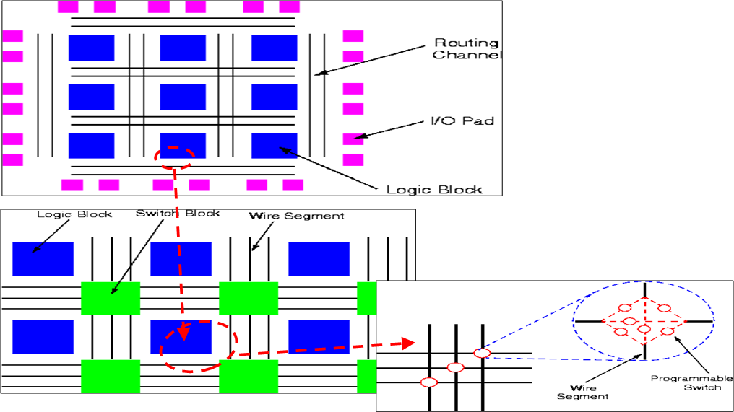
FPGA architecture

Slide 78
FPGA Structure
Logic block
I/O block
Interconnects

Slide 79
what does 'Field Programmable' mean?
Field Programmable means that the FPGA's function is defined by a user's program rather than by the manufacturer of the device.
A typical integrated circuit performs a particular function defined at the time of manufacture. In contrast, the FPGA's function is defined by a program written by someone other than the device manufacturer.
Depending on the particular device, the program is either 'burned' in permanently or semi-permanently as part of a board assembly process, or is loaded from an external memory each time the device is powered up.
This user programmability gives the user access to complex integrated designs without the high engineering costs associated with application specific integrated circuits.

Slide 80
How are FPGA programs created?
Individually defining the many switch connections and cell logic functions would be a daunting task.
This task is handled by special software. The software translates a user's schematic diagrams or textual hardware description language code then places and routes the translated design.
Most of the software packages have hooks to allow the user to influence implementation, placement and routing to obtain better performance and utilization of the device.
Libraries of more complex function macros (eg. adders) further simplify the design process by providing common circuits that are already optimized for speed or area.

Slide 81
FPGA
SPLDs and CPLDs are relatively small and useful for simple logic devices
Up to about 20000 gates
Field Programmable Gate Arrays (FPGA) can handle larger circuits
No AND/OR planes
Provide logic blocks, I/O blocks, and interconnection wires and switches
Logic blocks provide functionality
Interconnection switches allow logic blocks to be connected to each other and to the I/O pins

Slide 82
LUTs
Logic blocks are implemented using a lookup table (LUT)
Small number of inputs, one output
Contains storage cells that can be loaded with the desired values
A 2 input LUT uses 3 MUXes to implement any desired function of 2 variables
Shannon's expansion at work!
x
1
0/1
0/1
f
0/1
0/1
x
2

Slide 83
Programming an FPGA
ISP method is used
LUTs contain volatile storage cells
None of the other PLD technologies are volatile
FPGA storage cells are loaded via a PROM when power is first applied
The UP2 Education Board by Altera contains a JTAG port, a MAX 7000 CPLD, and a FLEX 10K FPGA
The MAX 7000 CPLD chip is EPM7128SLC84-7
EPM7 → MAX 7000 family; 128 macrocells; LC84 → 84 pin PLCC package; 7 → speed grade

Slide 84
FPGA
FPGA applications:-
DSP
Software-defined radio
Aerospace
Defense system
ASIC Prototyping
Medical Imaging
Computer vision
Speech Recognition
Cryptography
Bioinformatic
And others.

Slide 85
Application Specific Chips (ASIC)
Custom Chips
PLDs are limited by number of programmable switches
Consume space
Reduce speed
Custom chips are created from scratch
Expensive → used when high speed is required, volume sales are expected, and chip size is small but with high density of gates
ASICs (Application Specific Integrated Circuits) are custom chips that use a standard cell layout to reduce design costs

Slide 86
Standard Cells
Standard Cells
Rows of logic gates can be connected by wires in the routing channels
Designers (via CAD tools) select prefab gates from a library and place them in rows
Interconnections are made by wires in routing channels
Multiple layers may be used to avoid short circuiting
A hard-wired connection between layers is called a via

Slide 87
Standard Cells

Slide 88
Example: Standard Cells
f₁ = x₁x₂ + x₁'x₂'x₃ + x₁x₃'
f₂ = x₁x₂ + x₁'x₂'x₃ + x₁x₃

Slide 89
Sea of Gates Gate Array
Sea of Gates Gate Array
A Sea of Gates gate array is just like a standard cell except all gates are of the same type
Interconnections are run in channels and use multiple layers
Cheaper to manufacture due to regularity

Slide 90
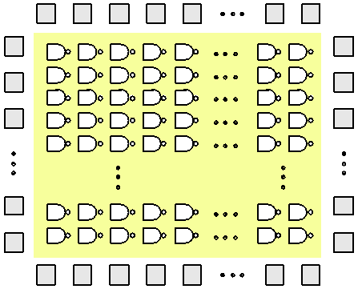
Sea of Gates Gate Array

Slide 91
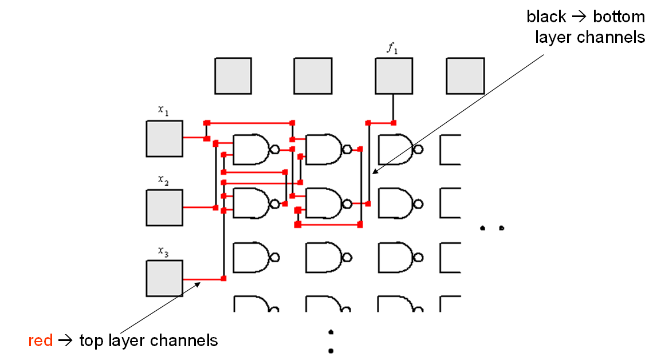
Example: Sea of Gates
f₁ = x₂x₃' + x₁x₃

